Slide 1
ENTERPRISE ARCHITECTURE
Common Failure Modes
Infinite Loops: this calls the agent over and over. Solution: step limit per task (max 20 steps)
Hallucinated tool calls : agent invents tool that doesn’t exist or calls a real tool with some nonsense parameter. Solution: strict registry and validation
Context overflow : agent state grows so large that you hit the LLMs context window. Solution: context pruning, summarization(Summarize the old tool result, drop irrelevant history)
Tool timeout cascades: circuit breakers
Prompt injection : input sanitization, separate validation model
Input Validator
Planner
Tool orchestrator
State management
Redis/Postgres, TTL
Cost Tracker
Per-task attribution
Tracer
OTel(spans, logs, metrics)
Feedback /Eval

Slide 2
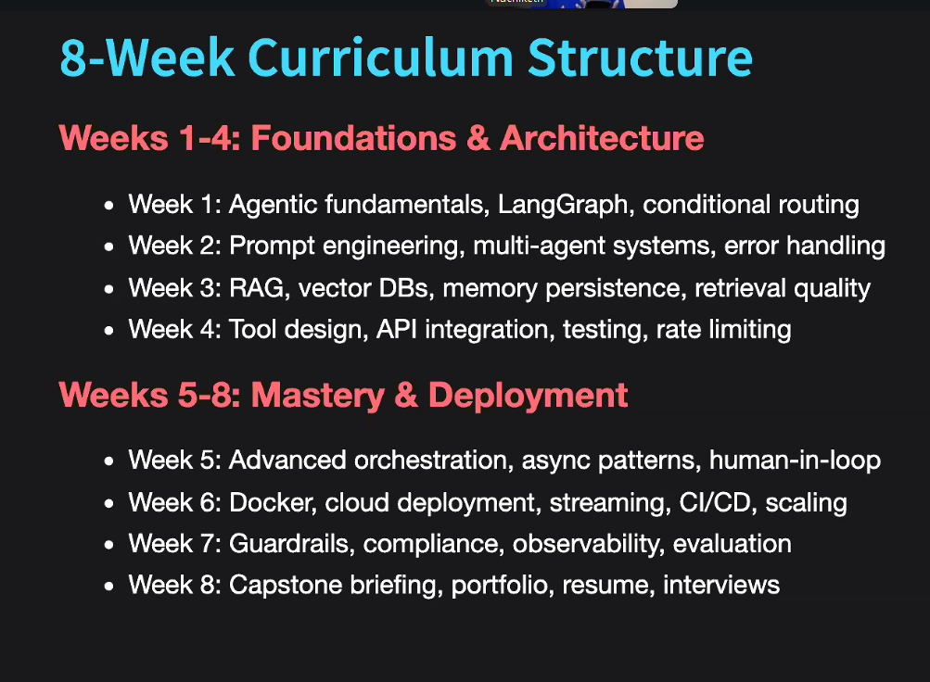
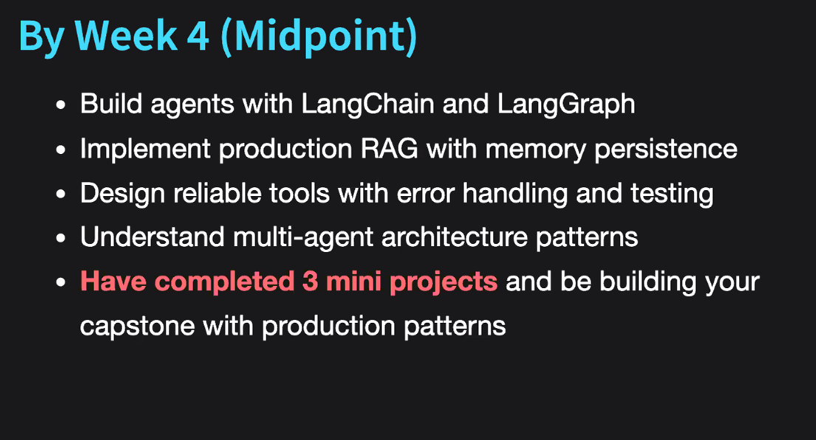
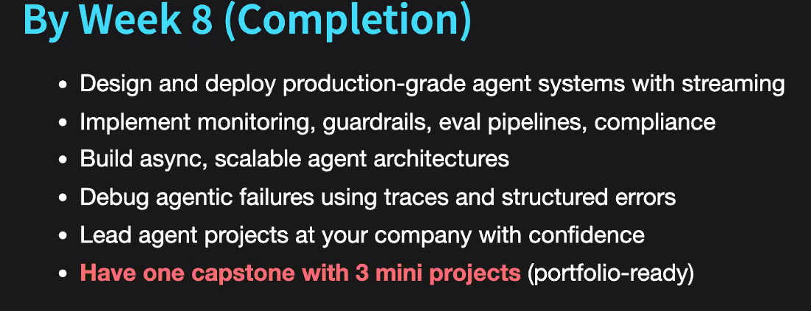
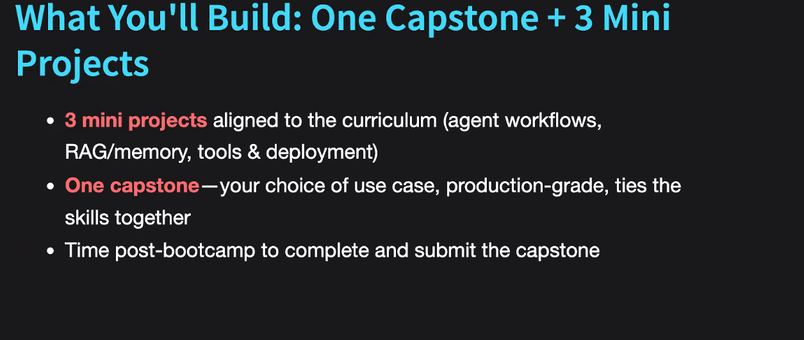

Slide 3
MICROSOFT AGENT FRAMEWORK
SEMANTIC KERNEL
Introduced skills, functions, planner & memory connectors
Brought structure to prompt structure
Planner was not reliable for multi-step scenarios
Middleware and security was wanting
AUTOGEN
Multi-agent collaboration
- Lacked enterprise-grade integration, MCP integration, observability, not aligned with Azure ecosystem(security,
WHAT WAS USED:
- Structured approach
WHAT WAS USED
- flexibility
MICROSOFT AGENT FRAMEWORK
Developer framework for building, orchestrating and managing AI Agents in a structured, scalable, secure way
Works perfectly with Azure
Modular and clean and extensible
Attach different tools, maintain conversation state using threads, connect data sources securely using MCP, build workflows to orchestrate different agents, insert middleware for guardrails, logging and validation, observe, debug and manage all the flows in a prod environment

Slide 4
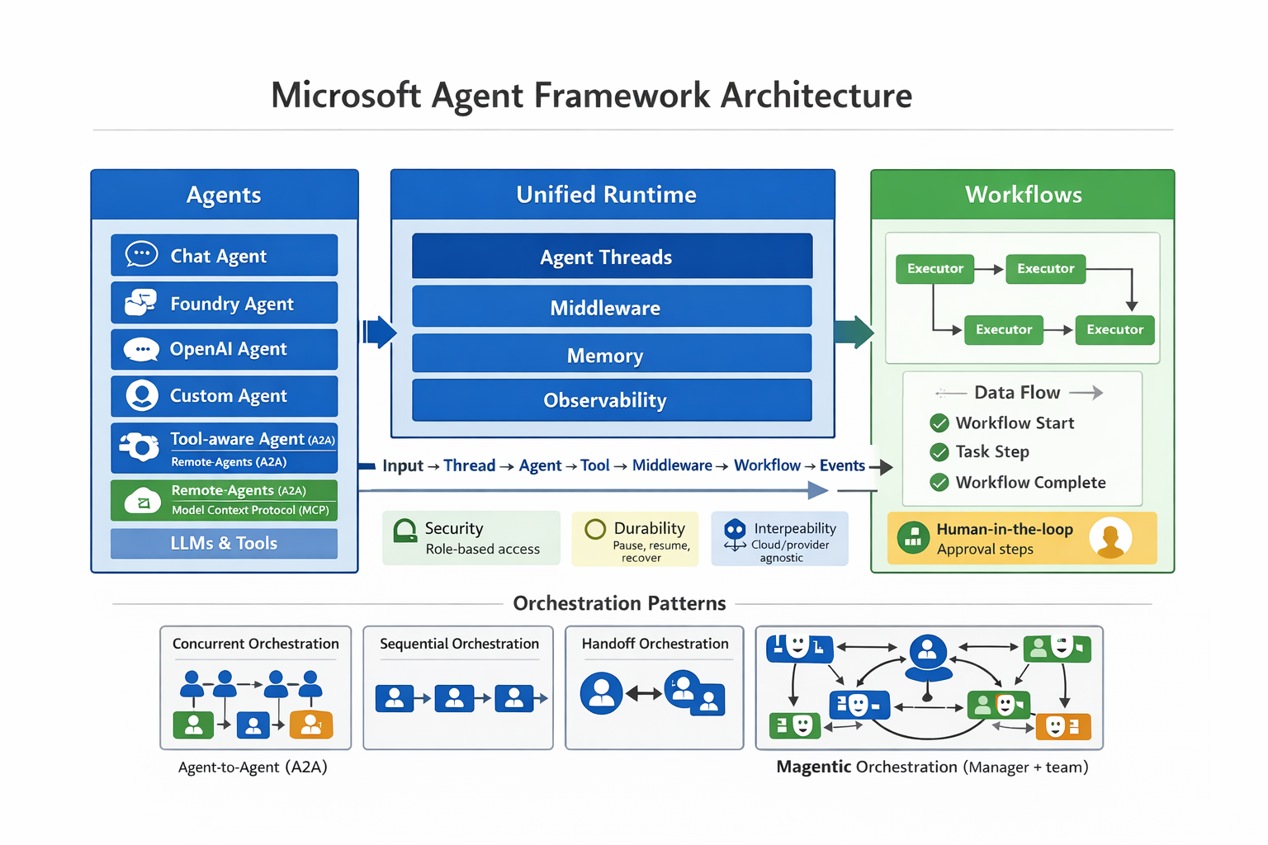

Slide 5
COMPONENTS DESCRIPTION
 | Function | Notes
Agents | Receive messages, reason using models and decide action to take | Can use built-in agents i.e.; ChatClient or custom agents Non-streaming mode: get response at once. Great for backend where once the agent has provided all information Streaming mode : receive partial tokens as they are generated. Great for chatbots or voice bots where you don’t have to wait for the agent to complete its response Structured output ie JSON useful for predicting output downstream
Threads | Stores conversation history and state. Each conversation happens inside a thread, allowing for multi-turn conversations | Every time an agent runs, it happens within a thread. In-memory(maintains context in a single conversation) Great for multi-turn conversation Makes conversations durable over sessions
Tools | Functions/APIs an agent can call to get work done. They can be in-built or custom tools | Makes an agent useful Can be attached on agent creation or dynamically at run time Model decides when to call a tool based on its schema or conversation Tool can be secured so the agent can only attach allowed functions. Crucial for enterprise solutions
Middleware | Layer that wraps around the agent and intercepts requests and responses for additional logic and transformation. Let’s you attach logging guardrails, authentication, transformation logic around agents or tools | Gives interception points around function calls or model interactions Agent Run middleware - wraps the entire agent run. Useful for logging and authentication Function calling middleware – wraps around a tool call. Useful for validation and security Chat client middleware – intercepts model calls. Useful for tracing and transformation Benefits: Maintainability( instead of adding these features to agents directly, plug them into middleware)
Workflows | Gives a way to wire multiple agents and steps together using executors and edges to build sequential or parallel flows | Graph-based orchestrations: each step is an executor and edges connect executors Has different orchestration patterns making multi-agent collaboration clean and manageable
MCP | Allows agents to dynamically discover and use external tool servers i.e.: DBs, APIs | Allows agent to connect to external MCP servers and discover tools dynamically i.e. : instead of hardcoding SQL connector or API, you can expose the DB via MCP, and the agent will query it securely during runtime Hence different teams can connect to the MCP server created and connect various agents to it

Slide 6
PRODUCTION-READY ARCHITECTURE: What should you do to make your solution production ready?
SERIALIZATION & DESERIALIZATION
Enhances memory/context storage and great for keep entire conversations
Serialization – converting the current state of the thread into a structure format (JSON)
Deserialization – constructing the initial thread from that structured format
Once a thread is serialized, it can be stored anywhere locally, SQL, Azure Blob, Redis(cache), NoSQL
On deserialization, the agent picks up the conversation from where it left before
CONTEXT PROVIDERS(LONG TERM MEMORY)
Context that learns, persists and adapts
Model decides which information is relevant and is stored as structured knowledge outside the thread
Memory is automatically injected into the prompt whenever the agents
Use cases: personalized copilots that remember your preference, previous answer
Saves on DB space, time, token usage, is efficient as it only picks key fact hence keeps context window light
MIDDLEWARE
Timing middleware: measures for long each interaction takes ; Useful in gauging performance of your agent(speed, latency spikes, delays); Runs around agent execution
Security middleware : checks what the user is sending before it gets to the model; Useful in blocking passing of sensitive info, prompt injection or attempts to violate security policies
Function middleware : wraps around functions/tools the agent uses; logs whenever an agent calls a tool and checks for function name, arguments, result after execution; useful since a lot of errors happen within tool calls hence you get full visibility into what is happening behind the scene
Token counter middleware: wraps around a model, it estimates input tokens before a request goes to the model and output tokens on the response of the model.
Message
OBSERVABILITY
Collects and logs all data and metadata in relation to the agent run
MCP
Self hosted MCP: run MCP server locally or within your own infrastructure. Great for full control of configuration, security, custom logic
Remote Hosted MCP: hosted by 3rd party service and you connect your agent to it. Useful for integrating external capabilities quickly
TIMING
AGENT
SECURITY
FUNCTION
TOKEN COUNTER

Slide 7
ORCHESTRATION PATTERNS
WORKFLOW BUILDING BLOCKS
Executors - unit of work responsible for a single task. Communicate with each other using typed messages(well-structured and predictable data)
Edges – connection between the executors
Events – give workflow interactivity and observability, Pause & resume, ask for user feedback, send output and observe what is happening at runtime
Shared states – allow different executors to share context without sending messages back and forth
Checkpoints – allow pausing and starting of workflows, Capture workflow state, enabling approvals and restarts with full traceability

Slide 8
MICROSOFT AGENT FRAMEWORK VS FOUNDRY AGENT SERVICE
MICROSOFT AGENT FRAMEWORK
Open-source SDK
Fine-grained control ie : orchestrations, memory, tools
Build on Semantic Kernel + AutoGen
Complex orchestration patterns
Agent Threads – multi-turn conversations
Interoperability with MCP, A2A, OpenAI API tools
Supports both simple and complex types
Flexible deployment options – ACA/AKS/Container Apps
FOUNDRY AGENT SERVICE (FAS)
Full managed enterprise runtime
Provides secure runtime with identity, networking, observability
Supports containerized hosted agents for any framework
Provide YAML + Visual agent workflows
Integrates with Foundry models, tools etc
CHOOSE FAS IF
Enterprise grade hosting
Network isolation, identity integration, RBAC
Large-scale observability, versioning and governance
Multi-agent workflow automation at production scale
Zero-infrastructure
CHOOSE MAF IF:
Custom orchestration patterns
Local development and debugging
Fine-grained control
Ability to mix models/providers
Extensible developer-driven architecture
HOW DO THEY WORK TOGETHER
Shared runtime vision : unified abstractions, both support MCP, A2A, OpenAI tool interoperability
 | MAF | FAS
Primary Function | Build & orchestrate with SDK | Host, deploy and manage agents at scale
Developer focus | Code-first, flexible, modular | Fully managed, production first
Memory | Agent threads with persistent and ephemeral state | Service managed conversation threads
Orchestration | Advanced patterns | Enterprise workflows(YAML + visual)
Use cases | Custom agent logic | Production workloads, enterprise automation

